Slide 2
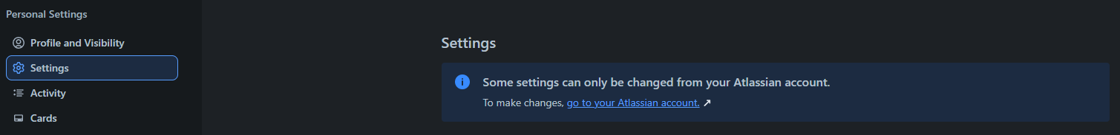



MAIN FUNCTIONALITY IN THE TRELLO SYSTEM
bbv Software Services AG | 21/07/2025

Slide 3
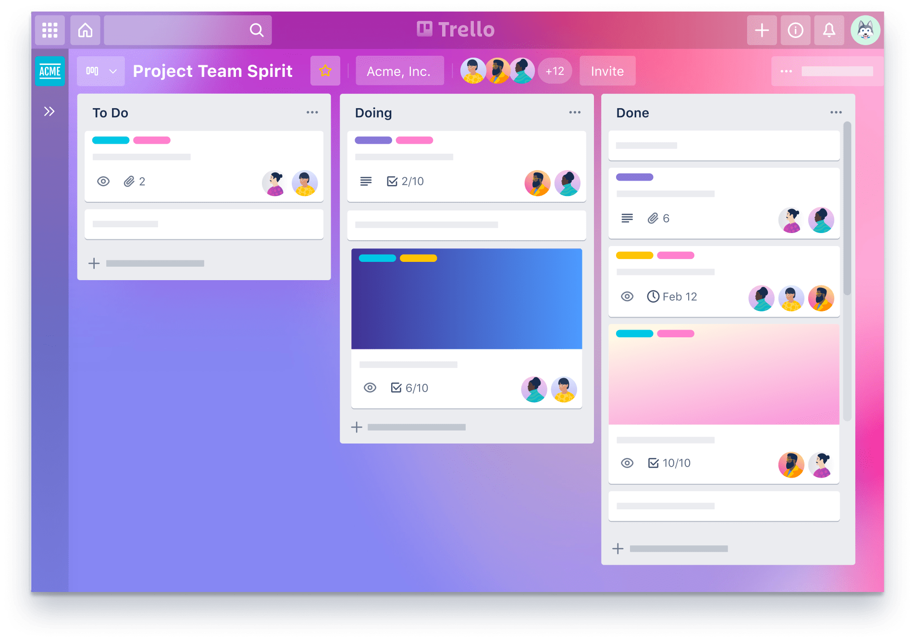
Agenda
Introduction to Functionality
UI in the Trello System
Entities in Trello System
Q&A

Slide 4
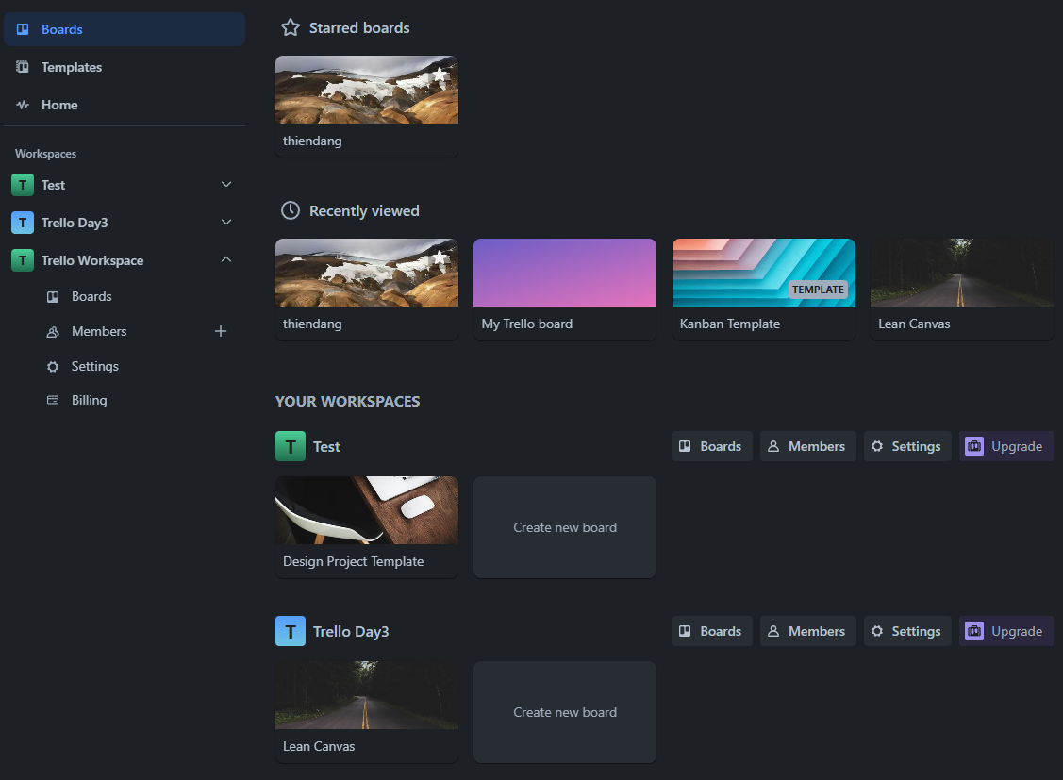
BOARDS TAB IN TRELLO SYSTEM
Board
Workspace
Notes:
1. Query 4 suggested template theo Template Category
2. Query 4 Board truy cập gần đây của user
3. Query tất cả Workspace mà User là Member
4. Query tất cả Workspace mà User là Member. Trong mỗi workspace đó, lấy tất cả Board mà User cũng là Member
5. Query tất cả closed boards mà user là member

Slide 5
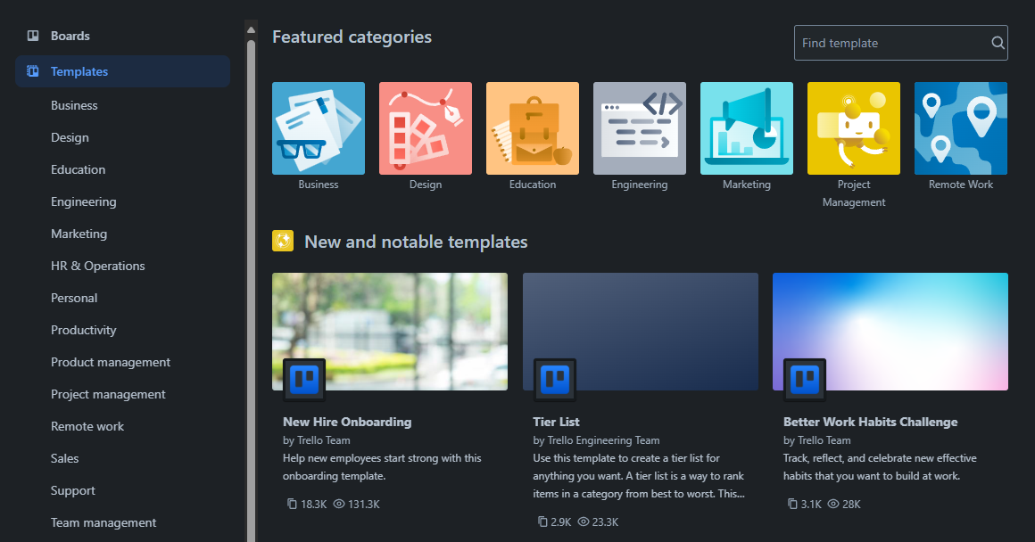
TEMPLATE TAB IN TRELLO SYSTEM
TemplateCategory
Template
Notes:
6. Lấy ra 10 template categories
7. Lấy ra New and notable templates

Slide 6
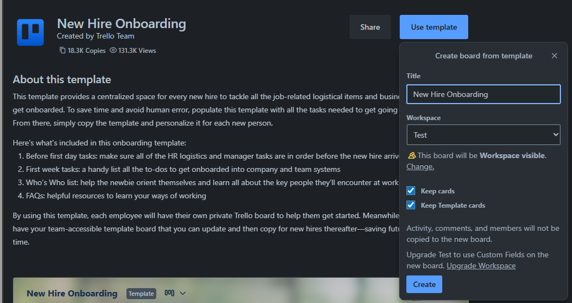
TEMPLATE IN TRELLO SYSTEM
Template
Board
Notes:
8. Lấy ra template detail và Board đi theo template đó

Slide 7

CREATE WORKSPACE IN TRELLO SYSTEM
Workspace Information
Notes:
9. Insert data vào Workspaces

Slide 8
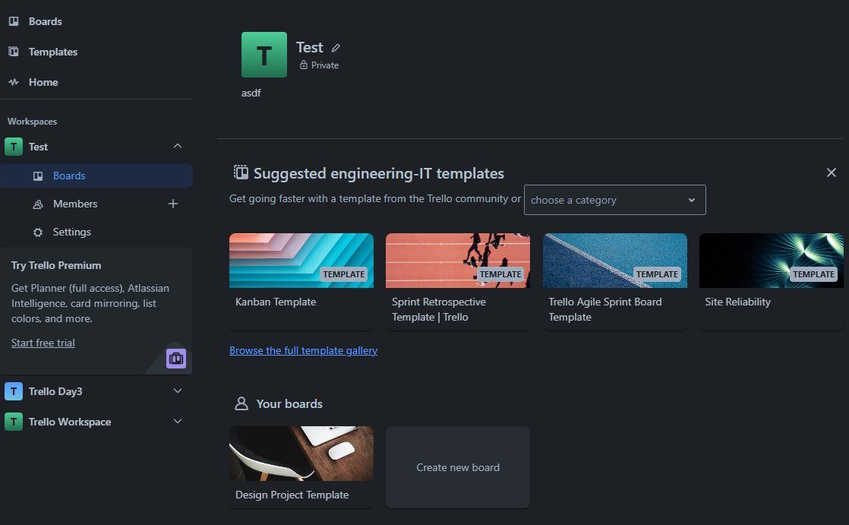
WORKSPACE IN TRELLO SYSTEM
Click here
Template
Board
Notes:
10. Lấy Workspace Name, SettingKey='visibility' và SettingValue liên quan đến SettingKeys của Workspace 11. Lấy 4 Board được đề xuất theo Template Category Type có status là Template
12. Lấy ra mục Your boards: Lấy ra Board thuộc Workspace mà User cũng là Member của Board

Slide 9
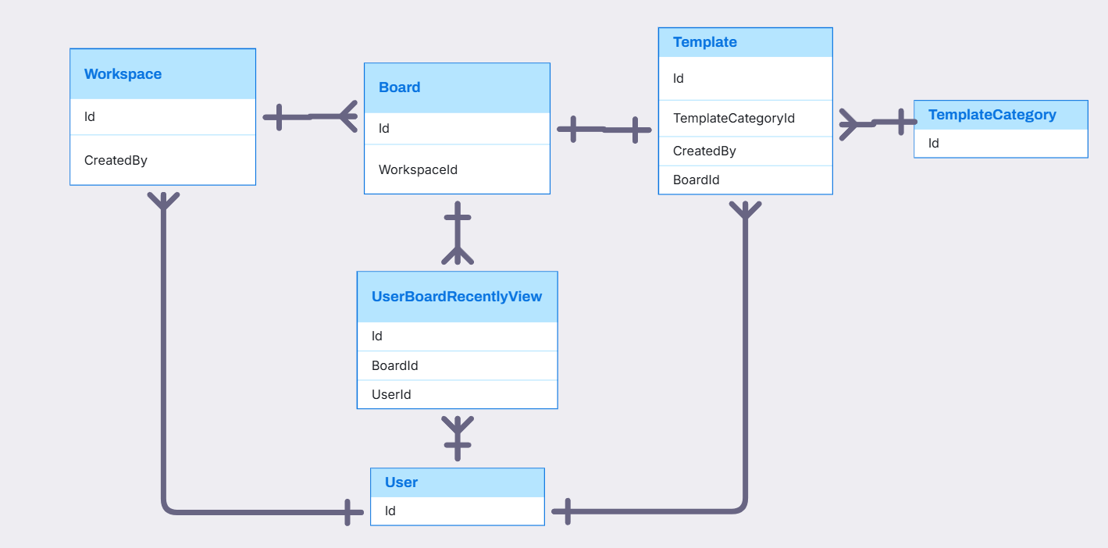
USER, WORKSPACE, BOARD, TEMPLATE, TEMPLATECATEGORY, USERBOARD RELATIONSHIP

Slide 10
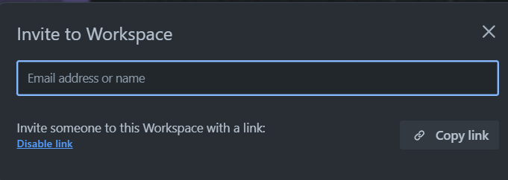
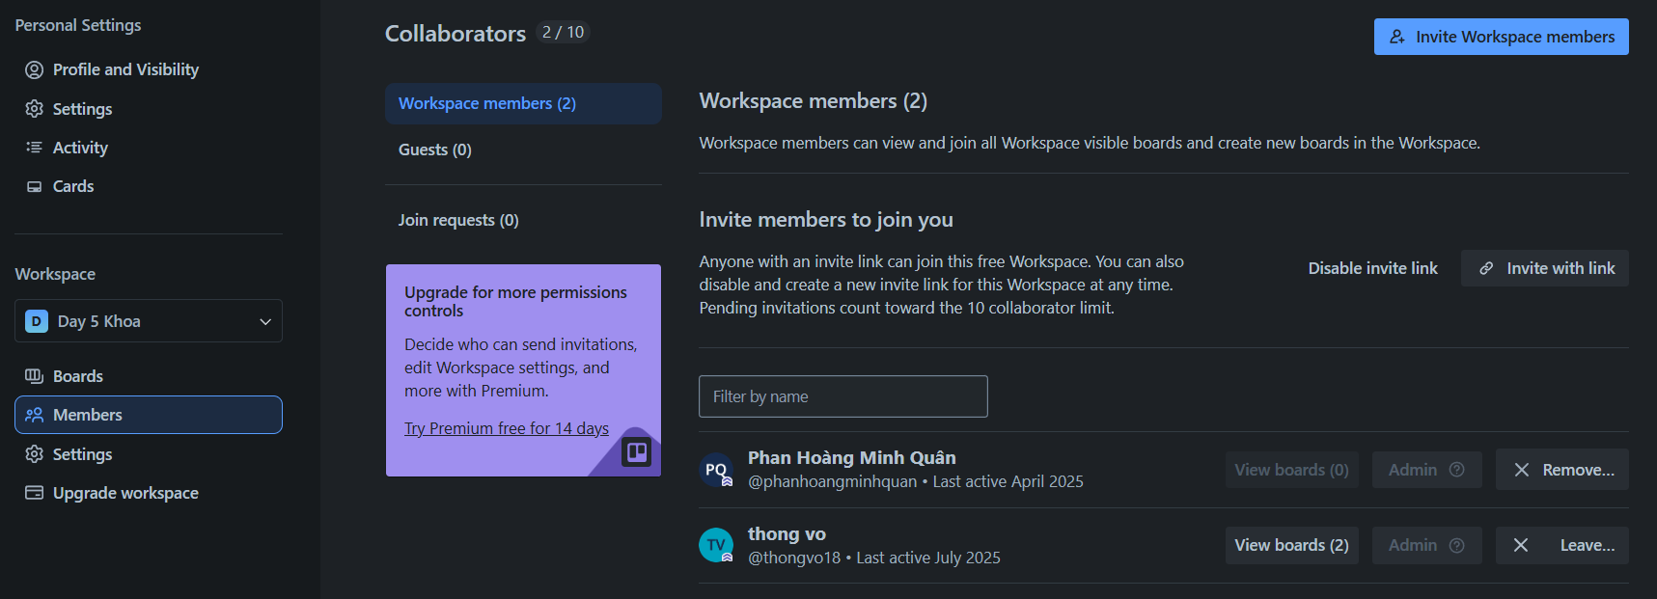
WORKSPACE IN TRELLO SYSTEM
ShareLink
Member
Permission
Notes:
--13. Lấy ra tất cả Member trong Workspace, số Board trong Workspace có Member đó tham gia và quyền trong Workspace tương ứng –14. Lấy ra sharelink của workspace và status của ShareLink –15. Update status ShareLink của Workspace

Slide 11
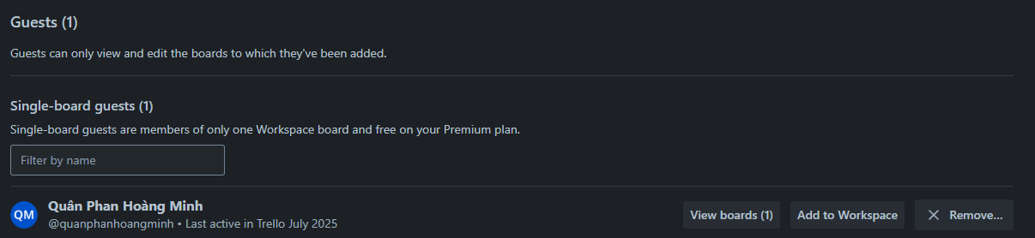
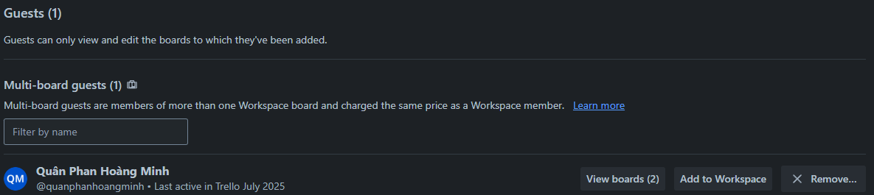
WORKSPACE IN TRELLO SYSTEM
Notes:
16. Query Member của Board thuộc Workspace. Nhưng Member đó không thuộc Workspace

Slide 12
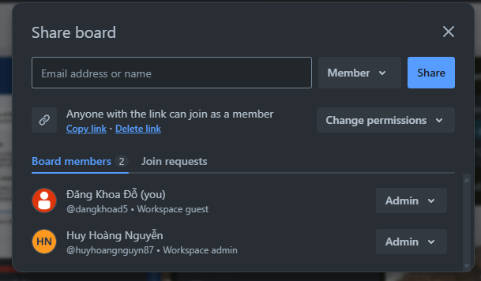
WORKSPACE IN TRELLO SYSTEM
ShareLink
Member
Permission
Notes:
--17. Add Member vào Board với Permission
--18. Add ShareLink cho Board có Permission
--19. Update Status, Permission của ShareLink
--20. Lấy ra tất cả Member của Board và Permission của Member

Slide 13
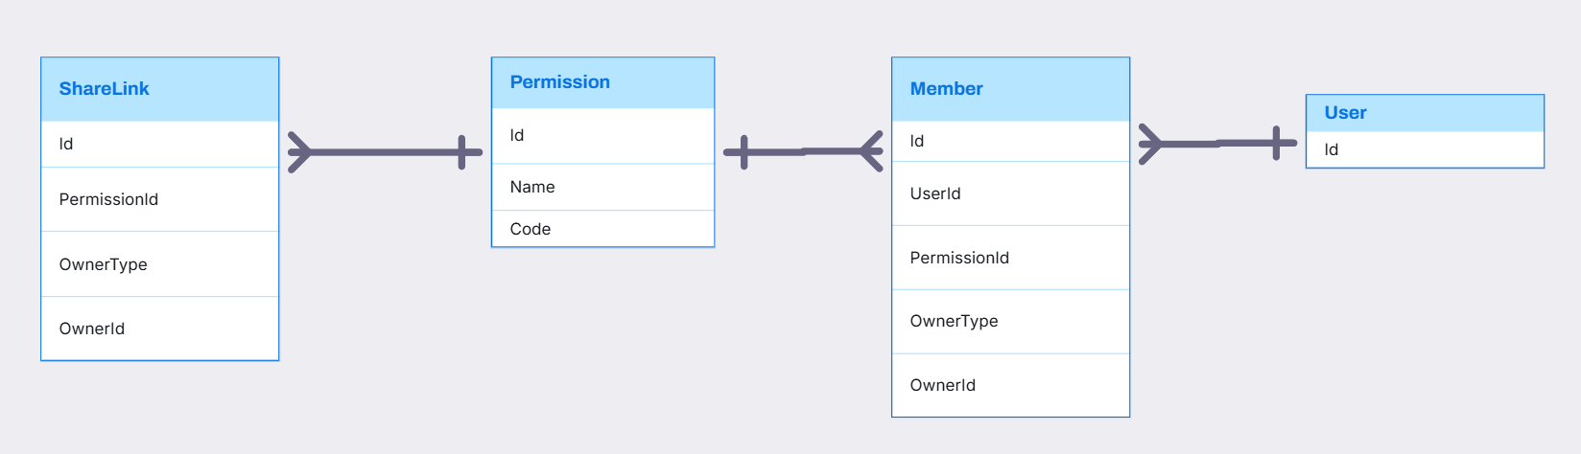
SHARELINK, PERMISSION, MEMBER RELATIONSHIP

Slide 14
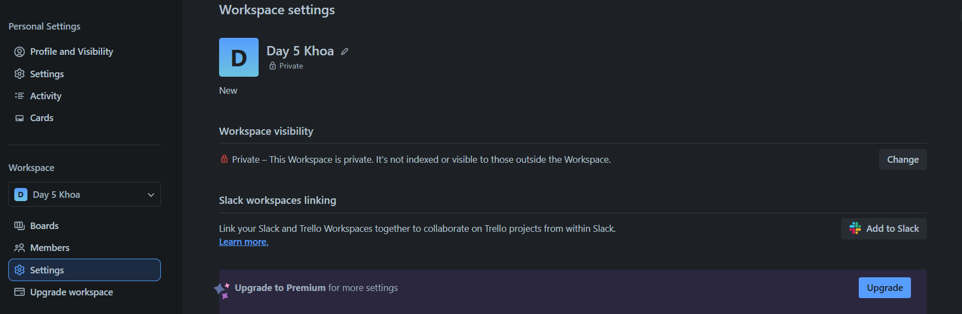
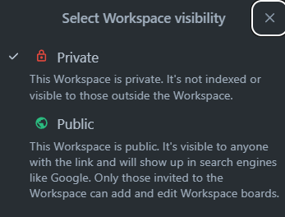
WORKSPACE SETTING IN TRELLO SYSTEM
SettingKey
SettingOption
SettingValue
Notes:
--21. SettingKey và các SettingOption tương ứng của Workspace
--22. SettingValue của Workspace cụ thể

Slide 15
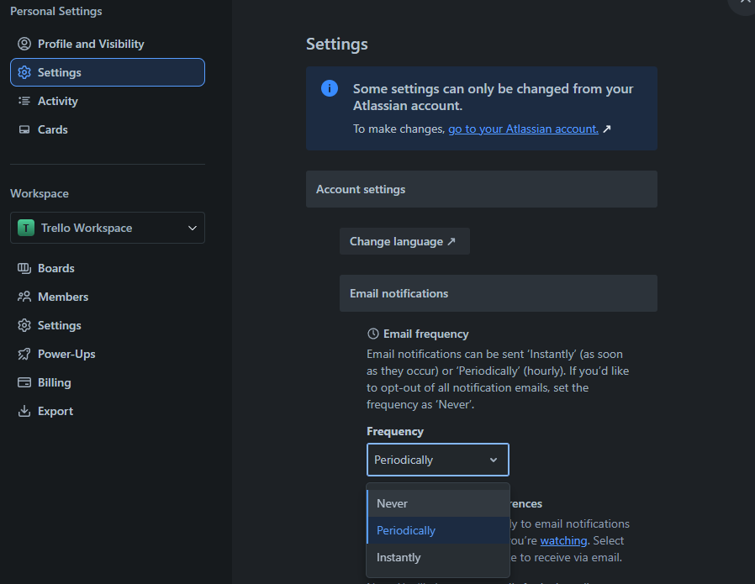
USER SETTING IN TRELLO SYSTEM
SettingKey
SettingValue
SettingOption

Slide 16
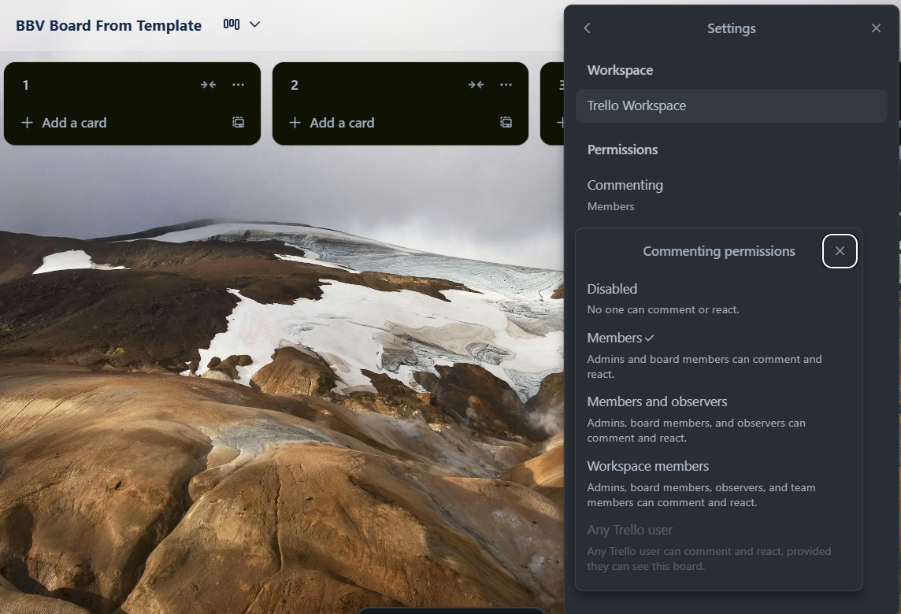
BOARD SETTING IN TRELLO SYSTEM
SettingKey
SettingValue
SettingOption

Slide 17
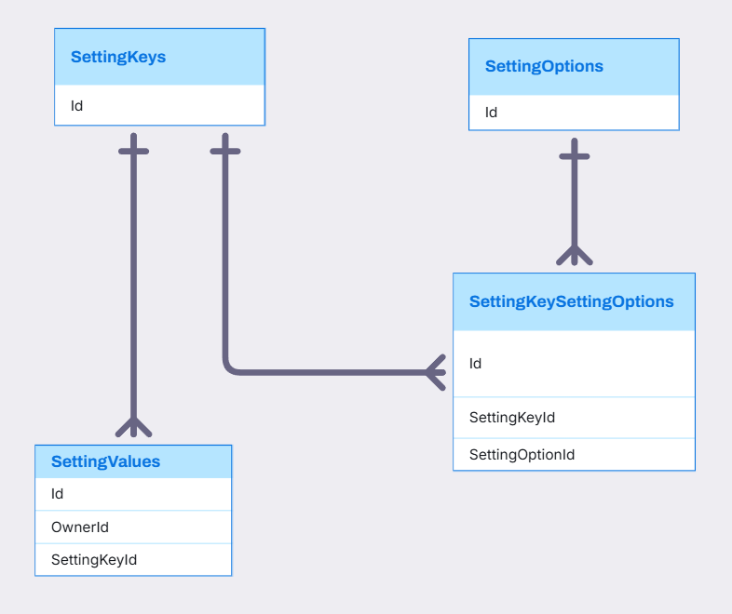
SETTINGKEY, SETTINGOPTION, SETTINGVALUE, SETTINGKEYSETTINGOPTION RELATIONSHIP

Slide 18
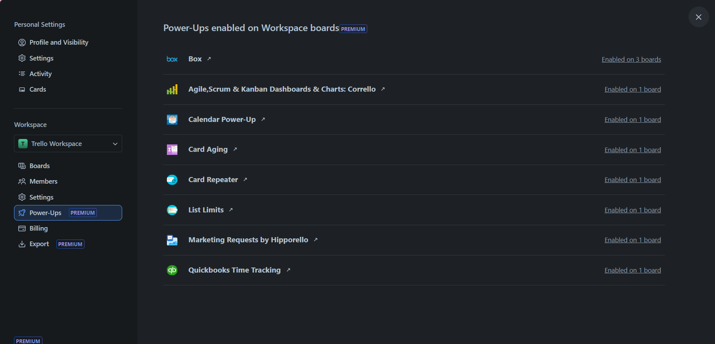
WORKSPACE IN TRELLO SYSTEM
Power-up

Slide 19
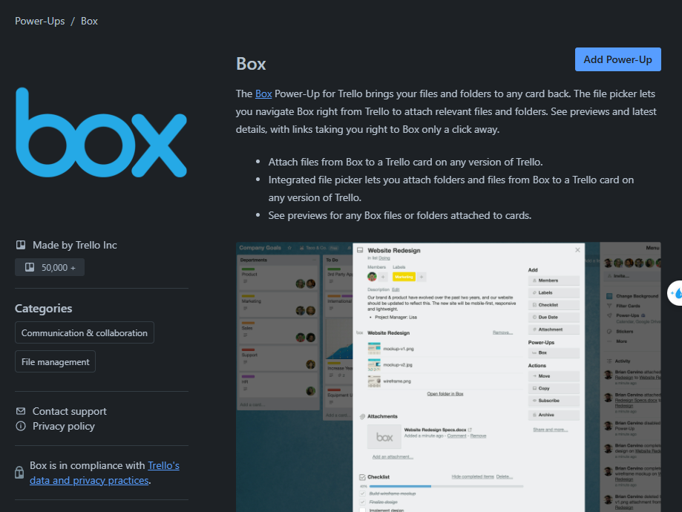
WORKSPACE IN TRELLO SYSTEM
Title
Description
AuthorName
PowerUpsCategory

Slide 20
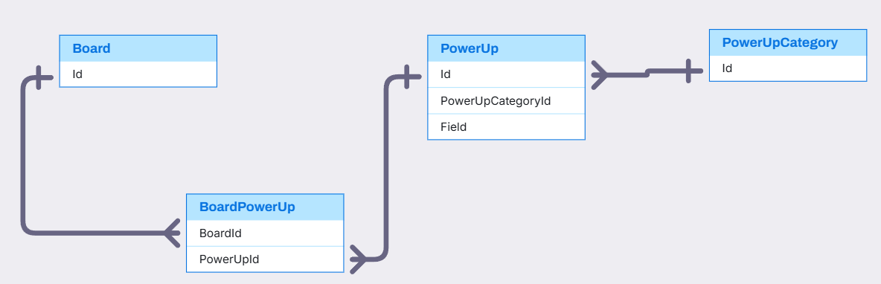
BOARD, POWERUP,POWERUPCATEGORY RELATIONSHIP
PowerUp,PowerUpCategory,Board(Quan)

Slide 21
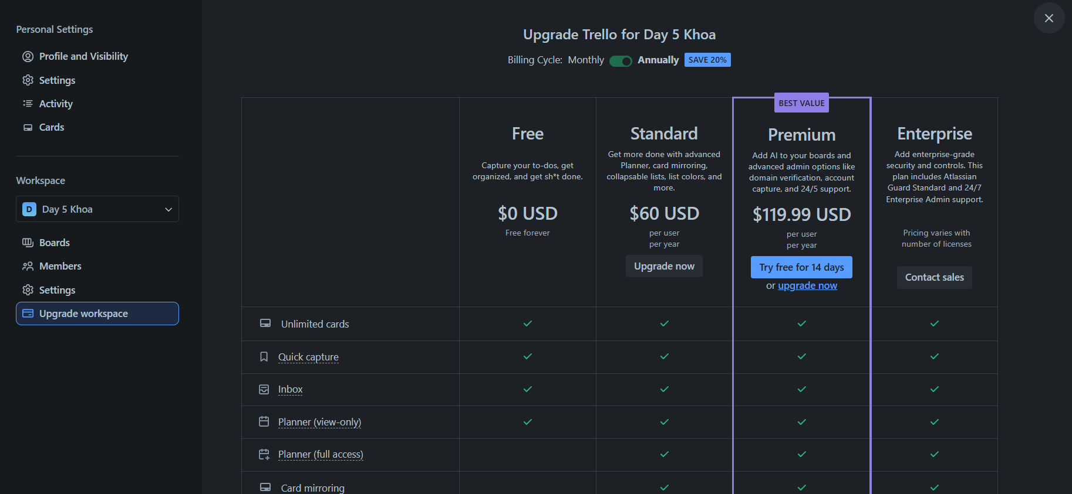
WORKSPACE IN TRELLO SYSTEM
BillingPlan

Slide 22
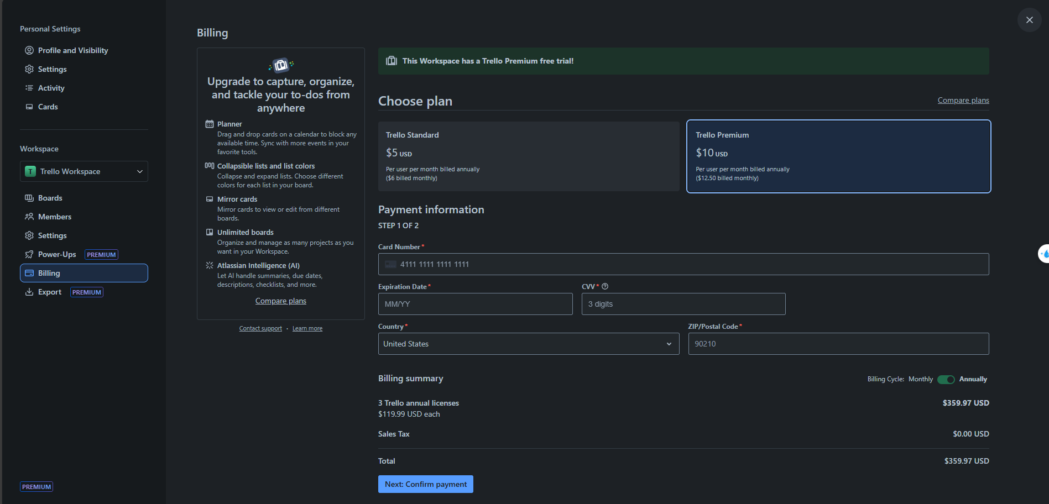
WORKSPACE IN TRELLO SYSTEM
BillingPlan
PaymentInformation

Slide 23
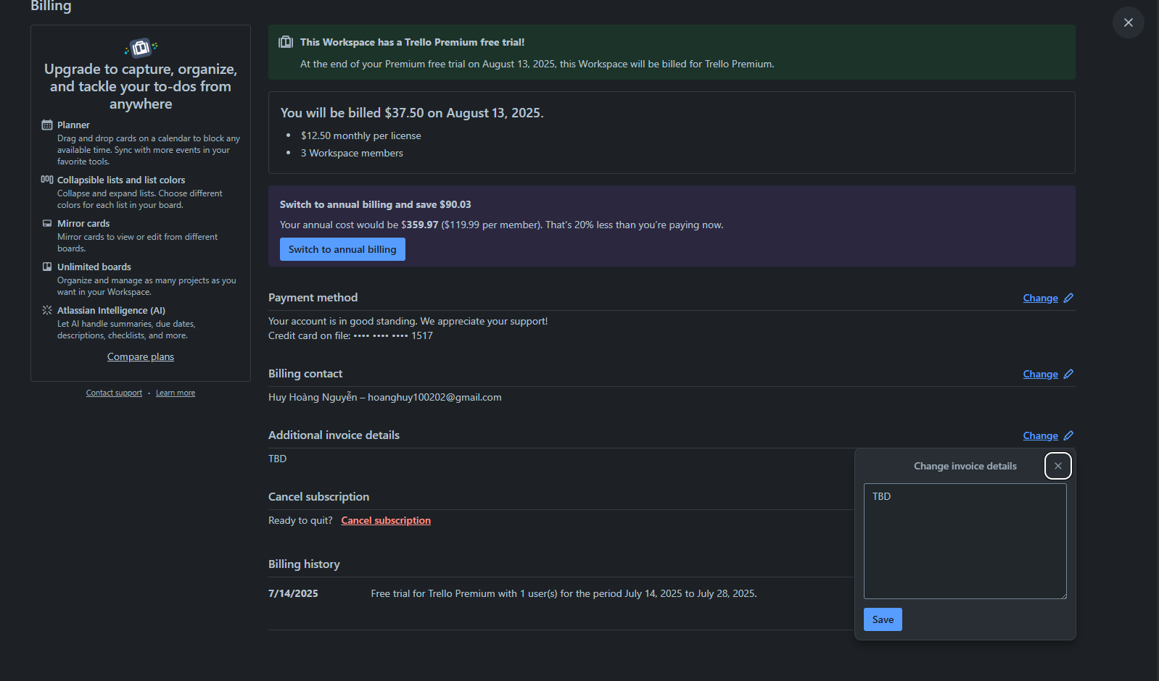
BILLING IN TRELLO SYSTEM
Billing.AdditionalInvoiceDetail

Slide 24
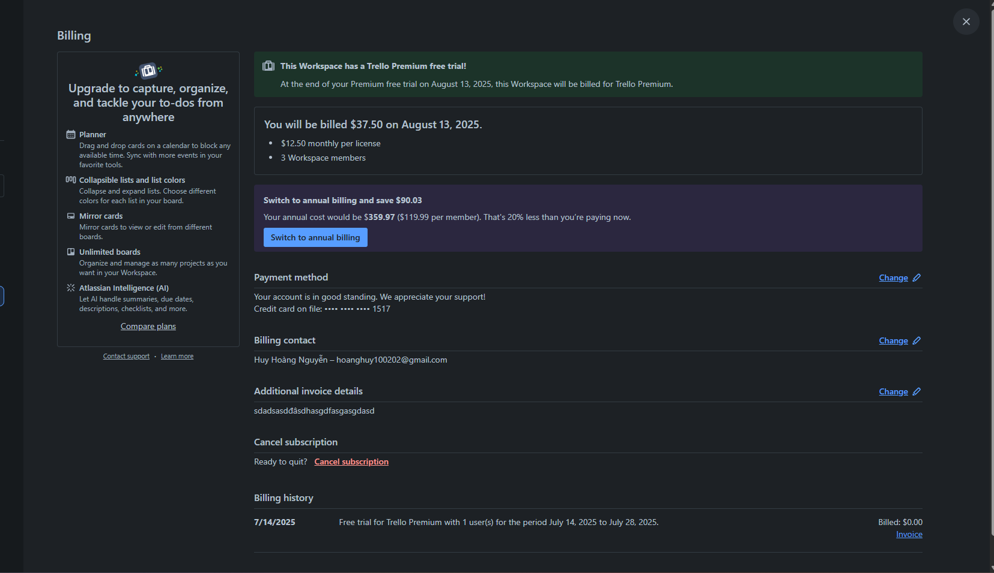
BILLING IN TRELLO SYSTEM
Subscription
Billing.AdditionalInvoiceDetail
Query from subscription

Slide 25
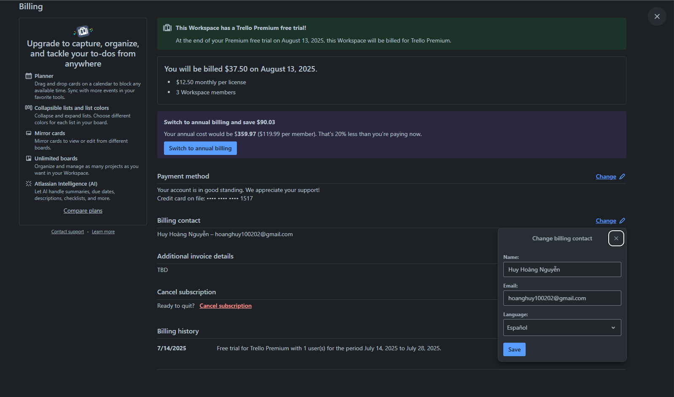
BILLING IN TRELLO SYSTEM
BillingContact

Slide 26
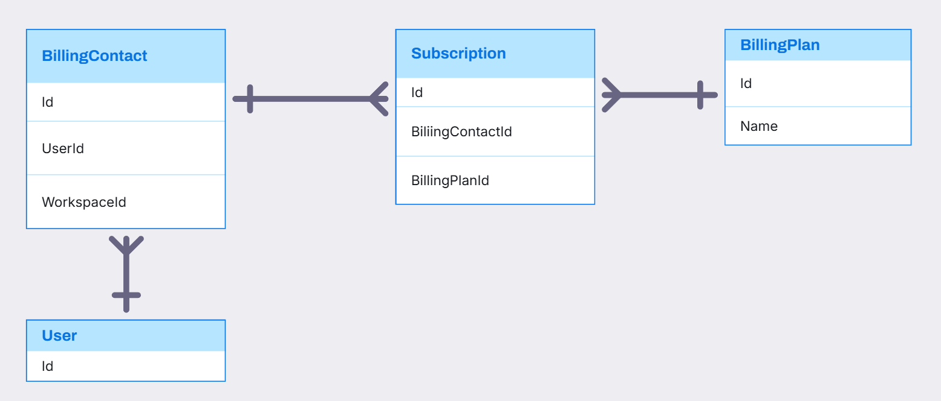
BILLINGCONTACT, BILLINGPLAN, SUBSCRIPTION RELATIONSHIP

Slide 27
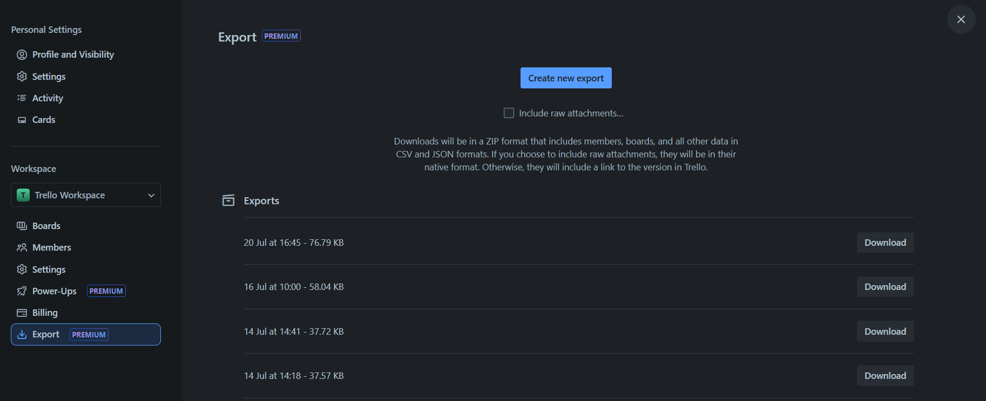
WORKSPACE IN TRELLO SYSTEM
Export

Slide 28
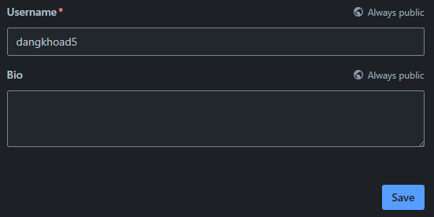
USER IN TRELLO SYSTEM
Username
UserBio

Slide 29
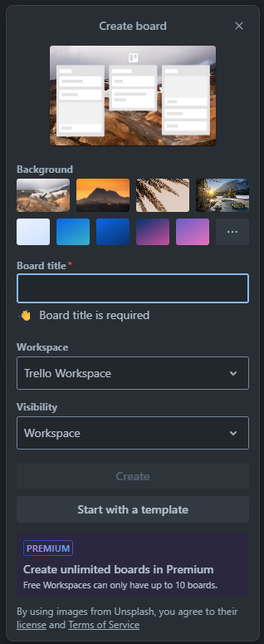
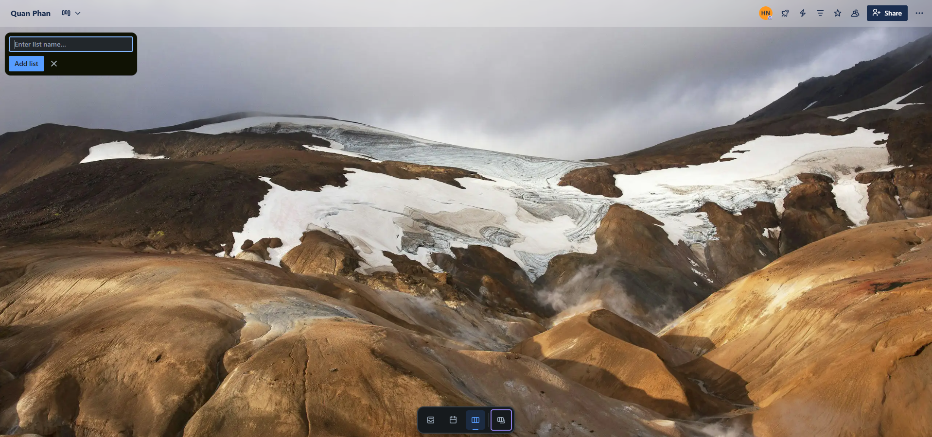
BOARD IN TRELLO SYSTEM
Stage
Board

Slide 30
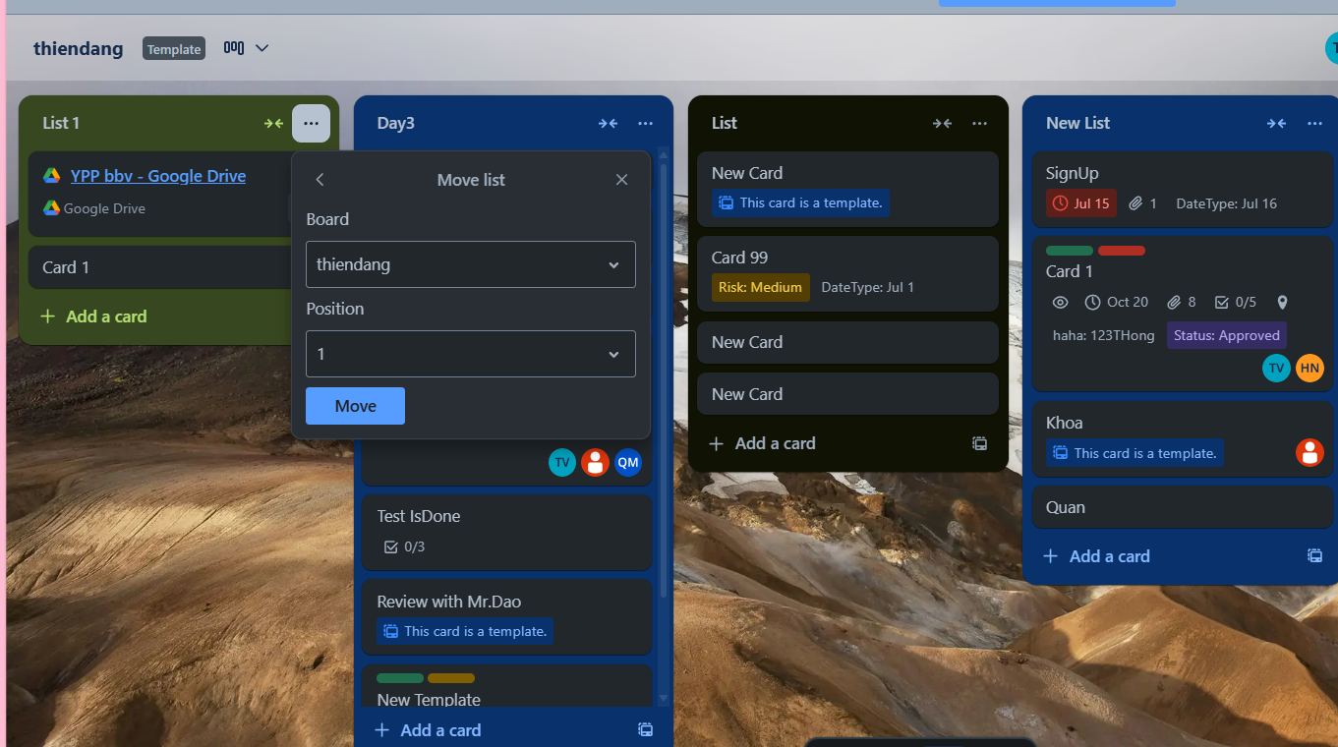
STAGE IN TRELLO SYSTEM
Stage Position

Slide 31
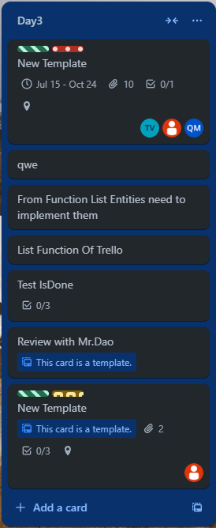
STAGE IN TRELLO SYSTEM
Stage
Card

Slide 32
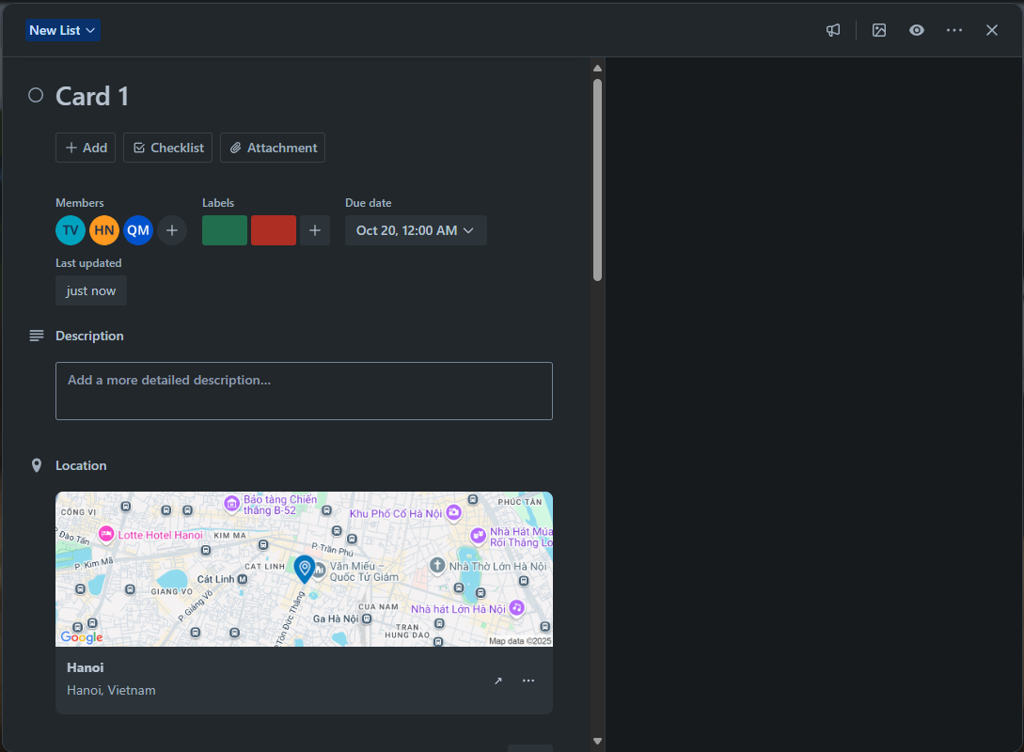
CARDS IN TRELLO SYSTEM
CardAssignMember
CardDate
Label
CardDescription
CardLocation

Slide 33
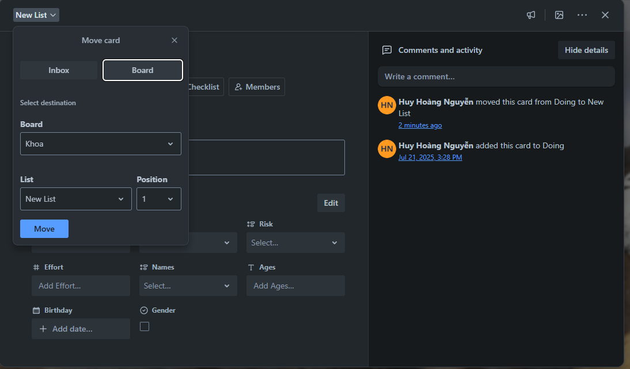
CARDS IN TRELLO SYSTEM
Card Comment
Card Position

Slide 34
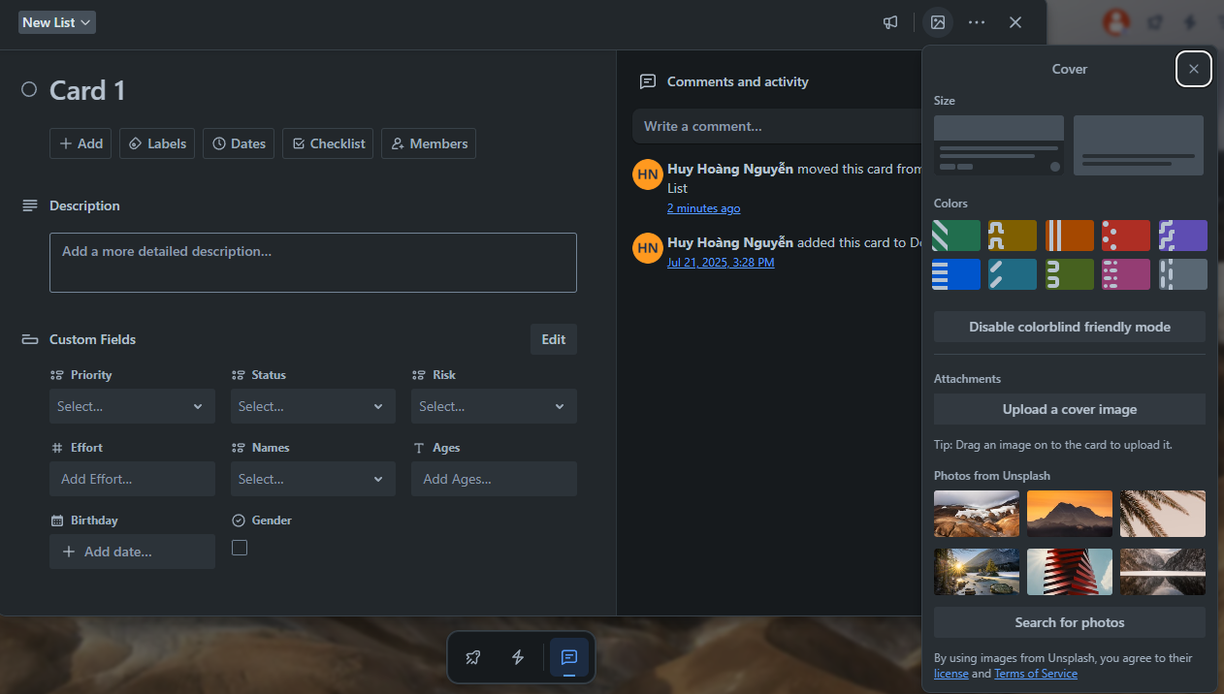
CARDS IN TRELLO SYSTEM
Color
Attachment
Card Cover
UnsplashImg

Slide 35
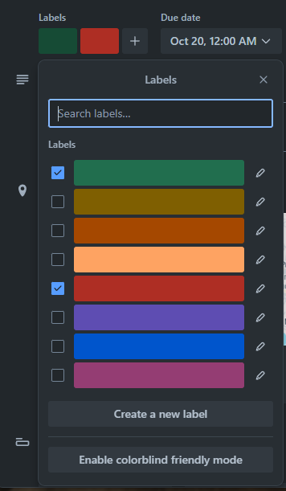
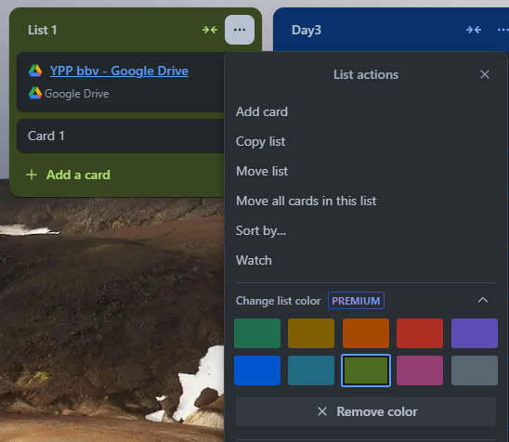
LABEL AND COLOR IN TRELLO SYSTEM
Label
Color

Slide 36
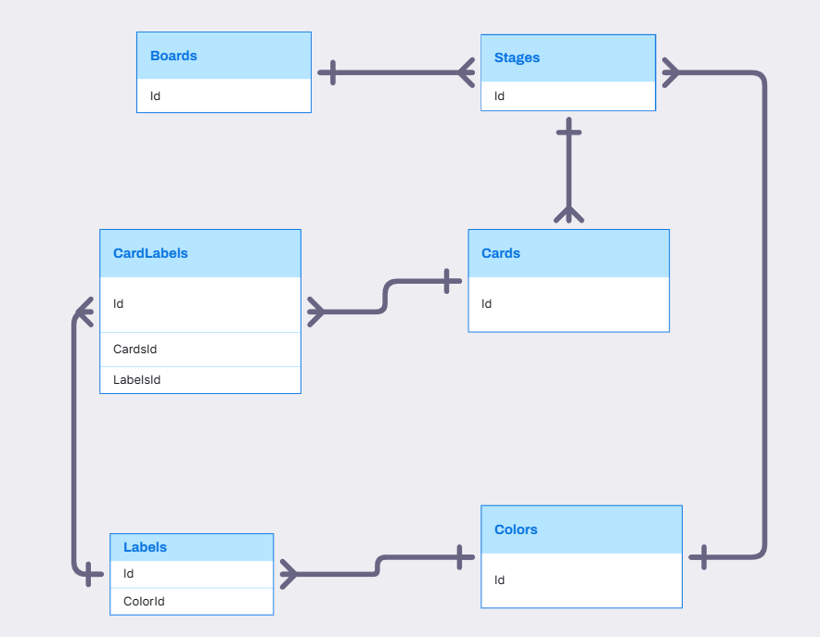
BOARD, STAGE, CARD, LABEL, COLOR RELATIONSHIP

Slide 37
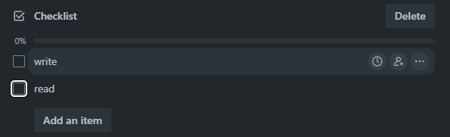
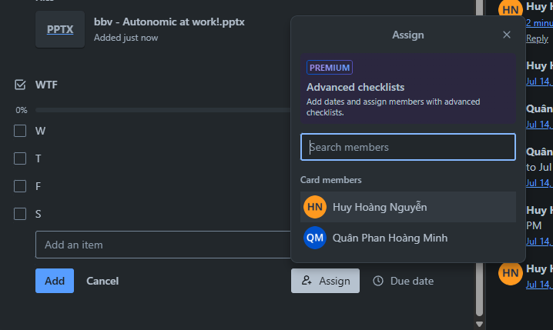
CHECKLIST IN TRELLO SYSTEM
CheckListItem
CheckList
Assign Member Into CheckListItem

Slide 38
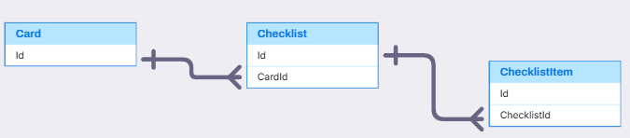
CARD, CHECKLIST, CHECKLISTITEM
Card, CheckList, CheckListItem(Quân)
,
,

Slide 39
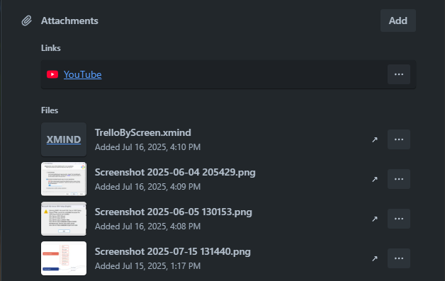
ATTACHMENT IN TRELLO SYSTEM
Attachment

Slide 40
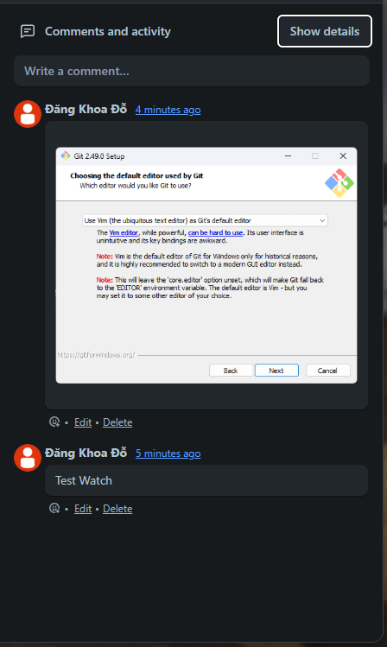
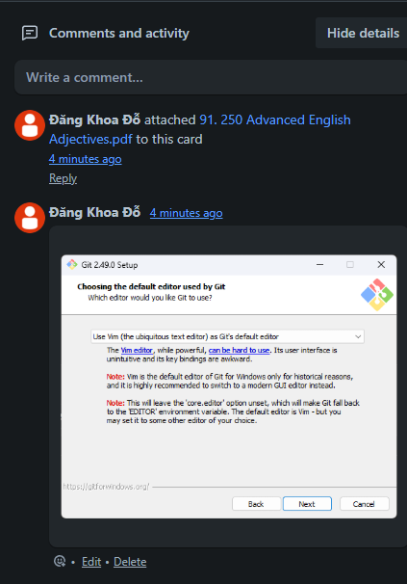
COMMENT IN TRELLO SYSTEM
Activity
Comment

Slide 41
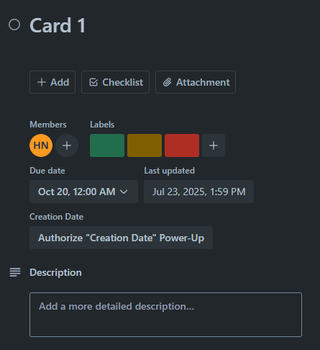
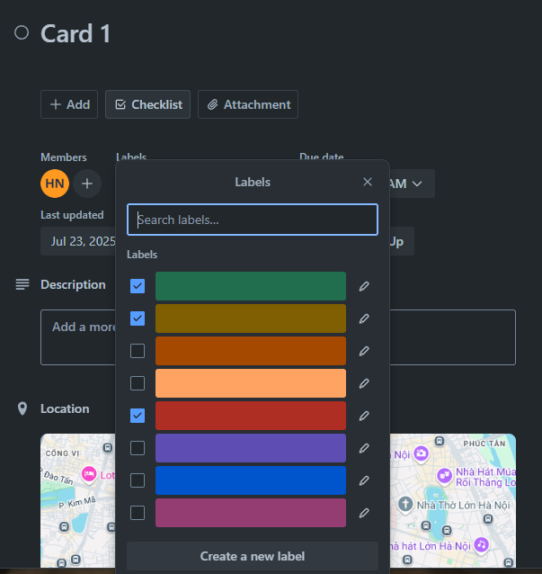
COMMENT IN TRELLO SYSTEM
Label
Label

Slide 42
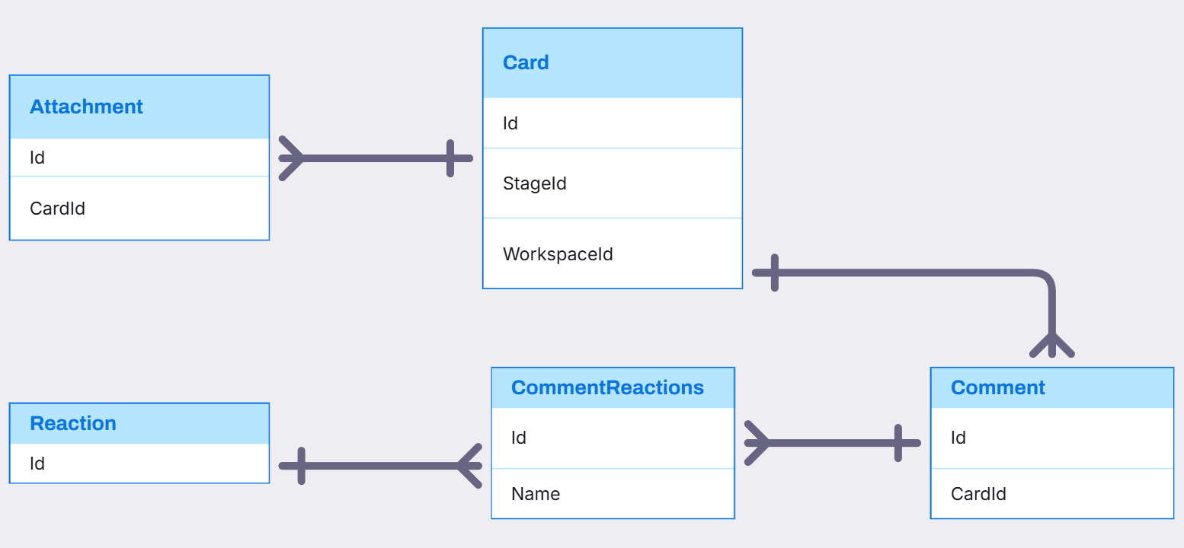
CARD, ATTACHMENT, COMMENT, REACTION RELATIONSHIP

Slide 43
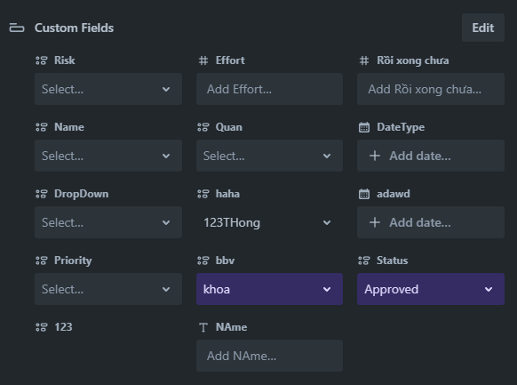
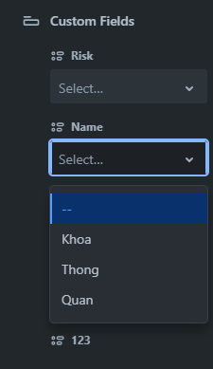
CARDS IN TRELLO SYSTEM
FieldItem
CustomField
FieldValue
FieldItem

Slide 44

Visily
Card, CustomField, FieldValue, FieldItem(Thông)
,
,

Slide 45



STICKERS IN TRELLO SYSTEM
Click Here
Drag To Here
Sticker

Slide 46

STICKERS IN TRELLO SYSTEM

Slide 47

HOME TAB IN TRELLO SYSTEM
Activity
TemplateCategory
Template

Slide 48

NOTIFICATION IN TRELLO SYSTEM
Notification

Slide 49

ACTIVITY, NOTIFICATION RELATIONSHIP

Slide 50

COLLECTION IN TRELLO SYSTEM
Collection
Board

Slide 51

COLLECTION, BOARD, BOARDCOLLECTION RELATIONSHIP

Slide 52

Q&A
Thank you
Intern | Trello Team

Slide 54
bbv template EN
How-to guides

Slide 55


bbv Master layouts & slide library
Insert new slide
1
Click on «New Slide»
1
2
Select layout
Choose the desired layout from the pre-programmed master layouts.
2
🡪
Or select layout from slide library

Slide 56




Transfer of existing slides into the new Master
1
2
3
4
Insert original slide
Copy slide in original presentation with Ctrl+C.
In the target presentation, select the slide after which the original slide is to be inserted.
Select in the tab «Home / Paste / Use Destination Theme».
Assign slide layout
Select the inserted slide
Select the desired layout in the tab «Home / Layout».
Adjust slide manually
Check all slide contents such as text blocks, images, etc. for position and size and manually adjust them to the new layout grid.
Check design
Independently check:
Font type, sizes and font colours
Colours of graphic elements
Text alignment
Coherence of the overall picture
Important:
When transferring existing slides, always carry out all four steps.

Slide 57


Change icon colour
Approach
Notes
Select icon
In the tab «Graphics Format» under «Graphics Styles», use «Graphics Fill» to change the colour
For some icons, the colour can be changed by using «Graphics Outline» instead of «Graphics Fill».
The colour cannot be changed if an icon is inserted as a picture. In this case, after selecting the icon, the tab «Picture Format» appears instead of «Graphics Format».
Best vector file format for icons: *.svg

Slide 58






Insert image into placeholder
Insert image from external source
Click on the image icon, select image from Sharepoint or other source
The bbv image library is here locally located: C:\Users\Public\bbv_templates\Marketing\PPT-Bibliotheken\Bilder-Bibliothek
Or: copy image from external source with Ctrl+C, select the placeholder, then paste with Ctrl+V
Adjust
Select the image
Click in the tab «Picture Format» on «Crop»
Adjust the image composition by moving the image
Resize the image by clicking and dragging the outer circles.
Click again on «Crop» to finish the adjustments

Slide 59






Insert image into mock-up screen (mobile/laptop)
Mock-up
Paste image
Copy image from external source with Ctrl+C and paste with Ctrl+V
Image mask
Adjust size & determine image area:
Place image behind image mask
Adjust image size and determine image area
Image mask
Crop image to image mask
Select image
Select image mask
Click in the tab «Shape Format / Merge Shapes» on «Intersect»
Combine image with mock-up
Place image behind mock-up
Activate image and mock-up and align both horizontally (Align Center) and vertically (Align Middle)
Group image and mock-up with Ctrl+G

Slide 60
bbv template EN
Style guide

Slide 61



Working area, guides & ruler
Working area
Depending on the slide, a single-column layout, a 2-column or 3-column layout is used.
Display the ruler and guides in the «View» tab.

Slide 62


bbv colour theme
Always OK!
Never, please!
Default text colours
Main accent
Colours for diagrams, charts, graphs etc.
Use selectively and sparingly
Never, please!
Colours for diagrams, charts, graphs etc.
Colours for diagrams, charts, graphs etc.

